Slide 1
Topic: Semi - structured, RDF, XML Databases
228884,
Mateusz Guściora

Slide 2

Agenda
Semi-structured data
RDF
XML databases
Questions/Discussion

Slide 3
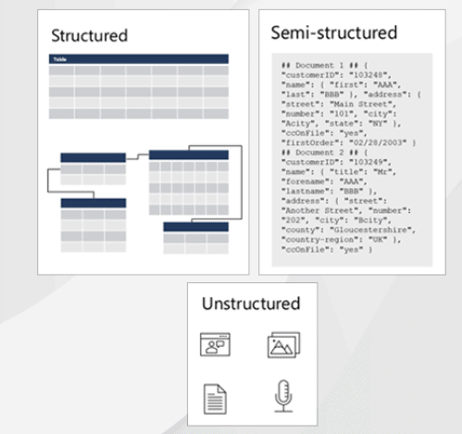
Semi-structured data
Semi-structured data is a mix of both structured and unstructured data.
It does not obey the tabular structure of data models but contains tags or other markers to separate semantic elements and enforce hierarchies
Source: https://onlineappsdba.com/

Slide 4


Characteristics of Semi-structured data
Data does not conforms to a data model but has some structure (lack of a well defined structure). No fixed schema.
Semi-structured data contains tags or other markers
Entities in the same group may or may not have the same attributes or properties
Does not contains sufficient metadata which makes automation and management of data difficult
Examples (sources of semi-structured data): XML, HTML, JSON, emails, call center logs, server logs, tweets organized by hastags, Integration of data from different sources.

Slide 5
Problems and Solutions
Main disadvantages:
Lack of fixed, rigid schema make it difficult in storage of the data
Interpreting the relationship between data is difficult
Queries are less efficient
Harder to browse and optimize
XML is widely used to store and exchange semi-structured data.
Object Exchange Model (OEM) can be used to store and exchange semi-structured data. OEM structures data in form of graph.
DBMS specially designed to store semi-structured data or RDBMS can be used to store the data by mapping the data to relational schema and then mapping it to a table.

Slide 6
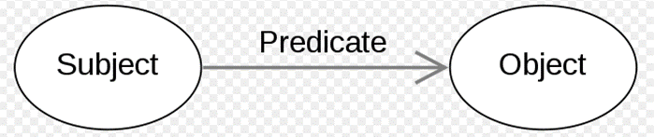

RDF – Resource Description Framework
Framework for semantics
Method for describing Web resources / represent data. Specifically design to store meaning allongside the data
RDF Triples

Slide 7
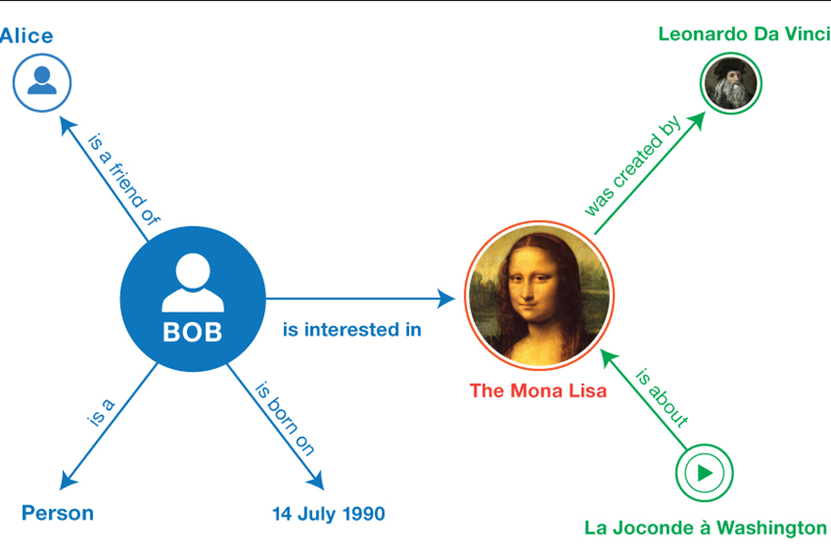
RDF graph
<Bob> <is a> <person>
<Bob> <is a friend of> <Alice>
<Bob> <is interested in> <Mona Lisa>
…
<Leonardo da Vinci>
<is the creator of>
<the Mona Lisa>
…
Source: https://www.w3.org/TR/rdf11-primer/

Slide 8
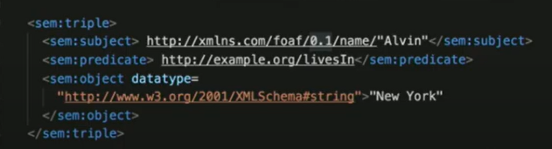
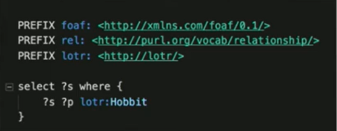
RDF Datatypes
RDF / JSON
RDF / XML → → →
RDF / TTL „turtle”
SPARQL (protocol & RDF query language) –
similar to sql, and let us Query and explore RDF data.

Slide 9
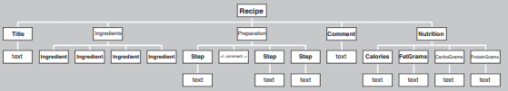

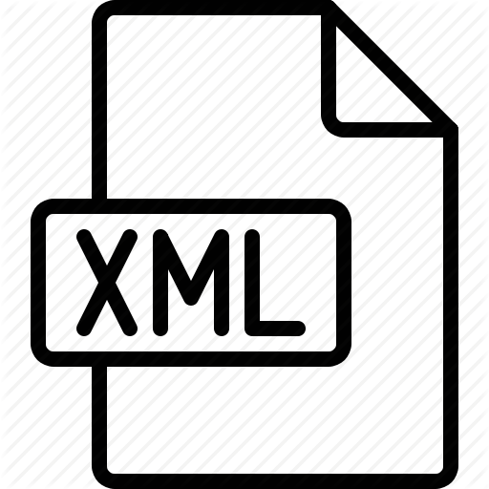
XML - eXtensible Markup Language
Data format/data model for sharing data between systems.
One of form is hierarchical (tree structure) and one form of representation is textual

Slide 10
XML databases
„An XML database is a data persistence software system that allows data to be specified, and sometimes stored, in XML format. This data can be queried, transformed, exported and returned to a calling system” (https://en.wikipedia.org/wiki/XML_database)
XML database types:
RDBMS (xml-enable db)
Native db

Slide 11
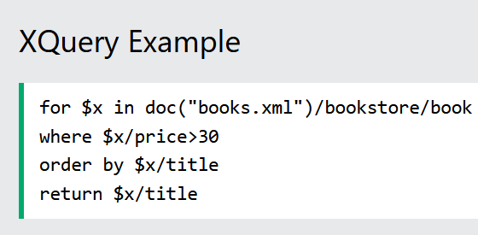
XML Query Language
XQuery - finding and extracting elements and attributes from XML documents.
XQuery is the language for querying XML data
XQuery is supported by all major databases
XQuery is a W3C Recommendation

Slide 12

Questions/Discussions

Slide 13
Sources
Practical RDF: Solving Problems with the Resource Description Framework: Shelley Powers, 2003
Principles of Distributed Database Systems, M. Tamer Özsu • Patrick Valduriez, III edition, 2011
Physical Database Design, Sam Lightstone, Toby Teorey, Tom Nadeau, 2007
https://en.wikipedia.org/wiki/XML_database
https://www.w3.org/
https://www.w3schools.com/xml/xquery_intro.asp
https://onlineappsdba.com/index.php/2020/10/21/structured-data-vs-unstructured-data-vs-semi-structured-data/
https://www.geeksforgeeks.org/what-is-semi-structured-data/
https://www.scibite.com/news/scibite-rdf-resource-description-framework-a-natural-semantic-fit/

Slide 14
thank you

